Slide 1



Experiment report with simple CNN
Lemon DC127461

Slide 2
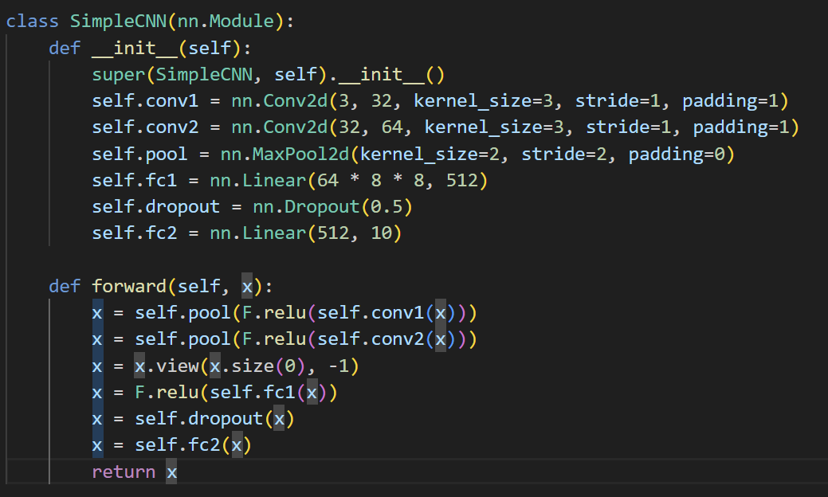
Brief introduction
7 layers
2 conv layer
2 pool
1 dropout
2 Fully Connected Layer

Slide 3

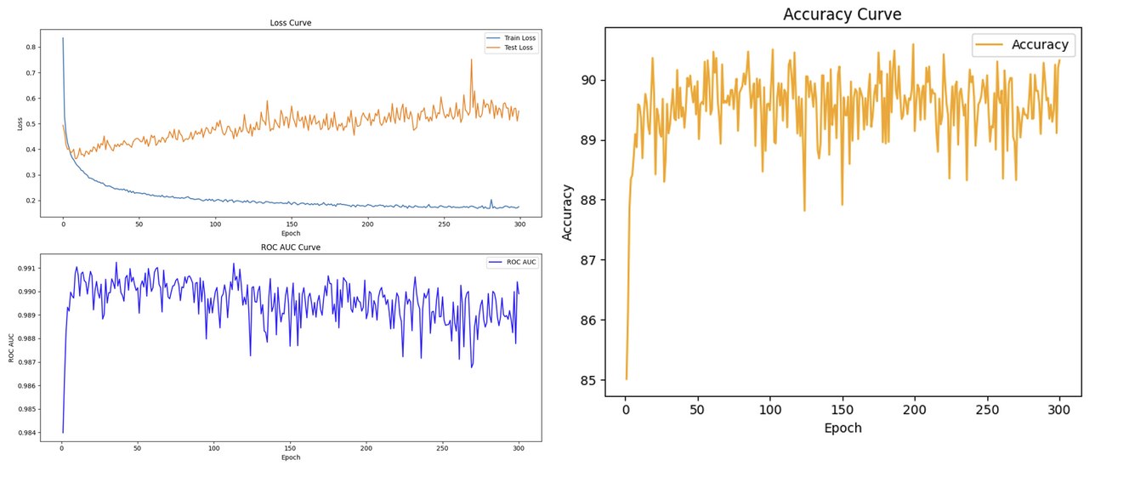
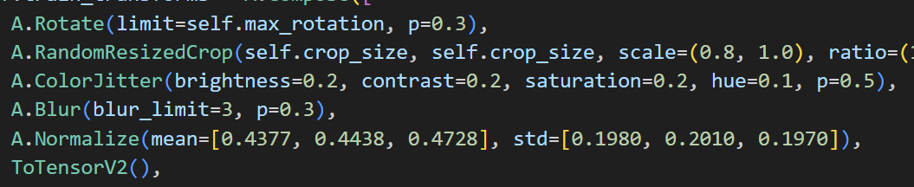
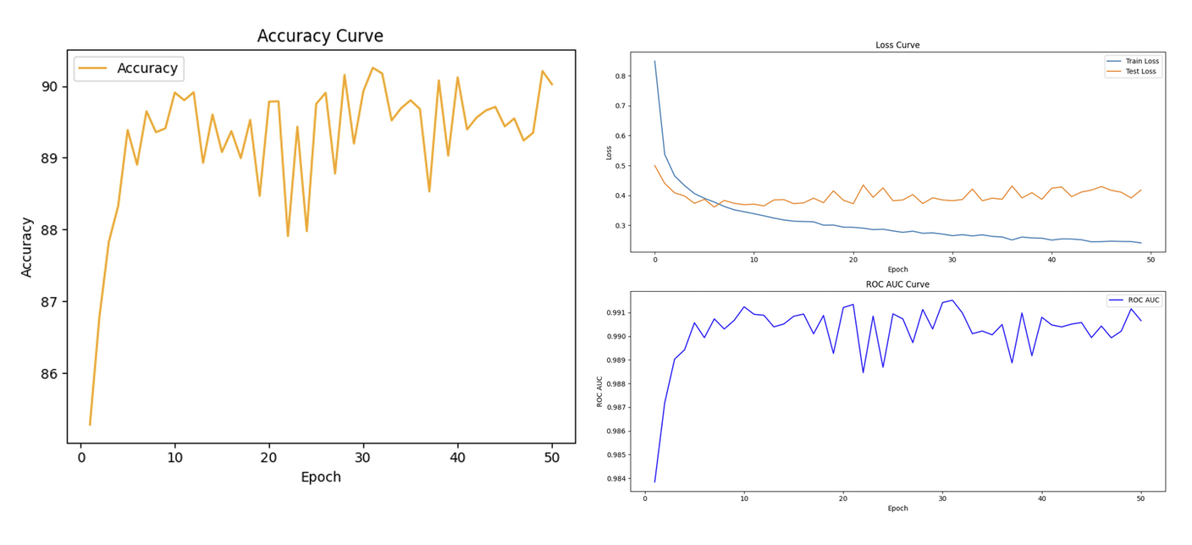
First test

Slide 4
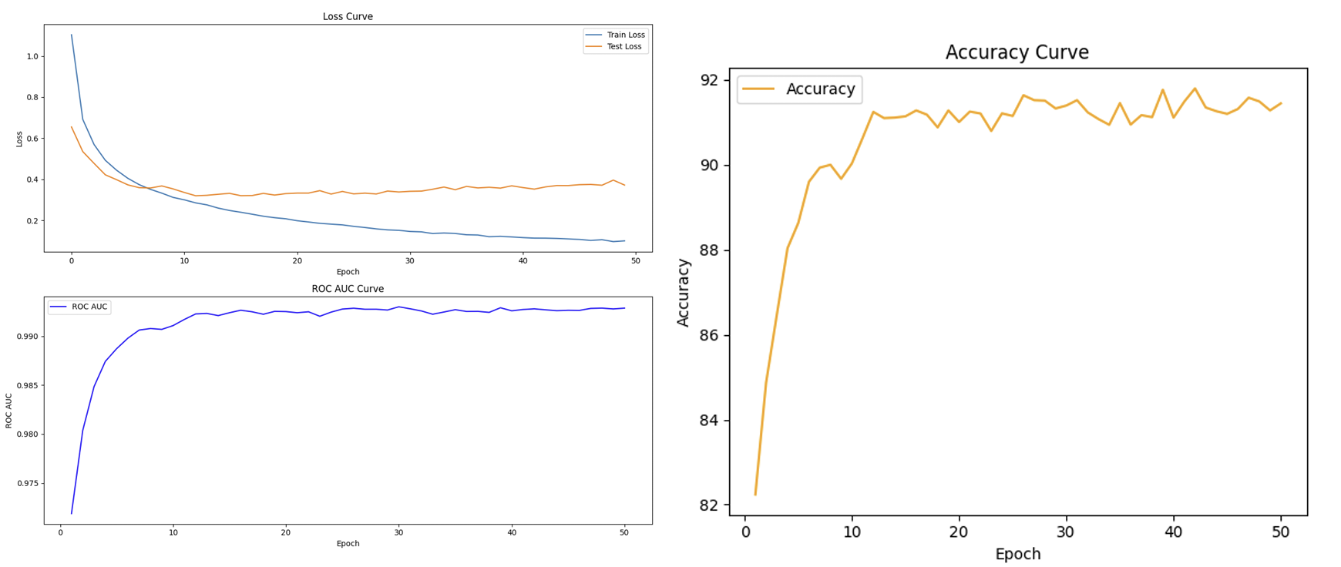
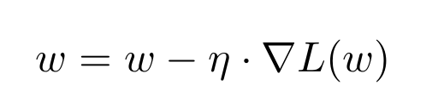
CHANGE LEARNING RATE
0.001 to 0.0001

Slide 5
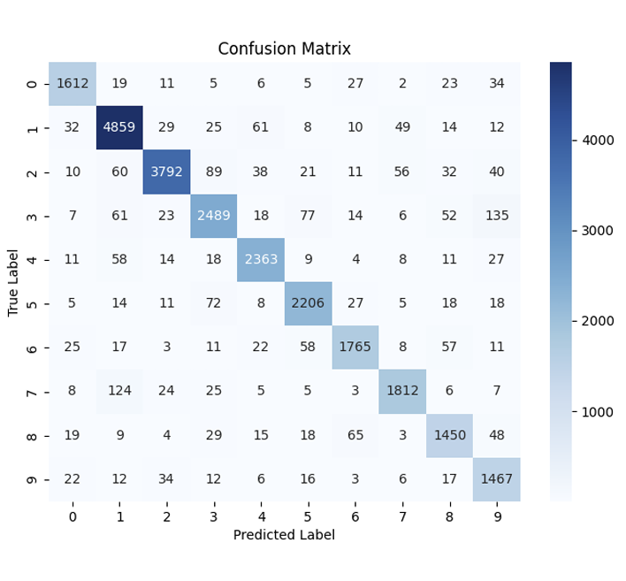
CONFUSION MATRIX

Slide 6
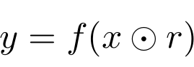
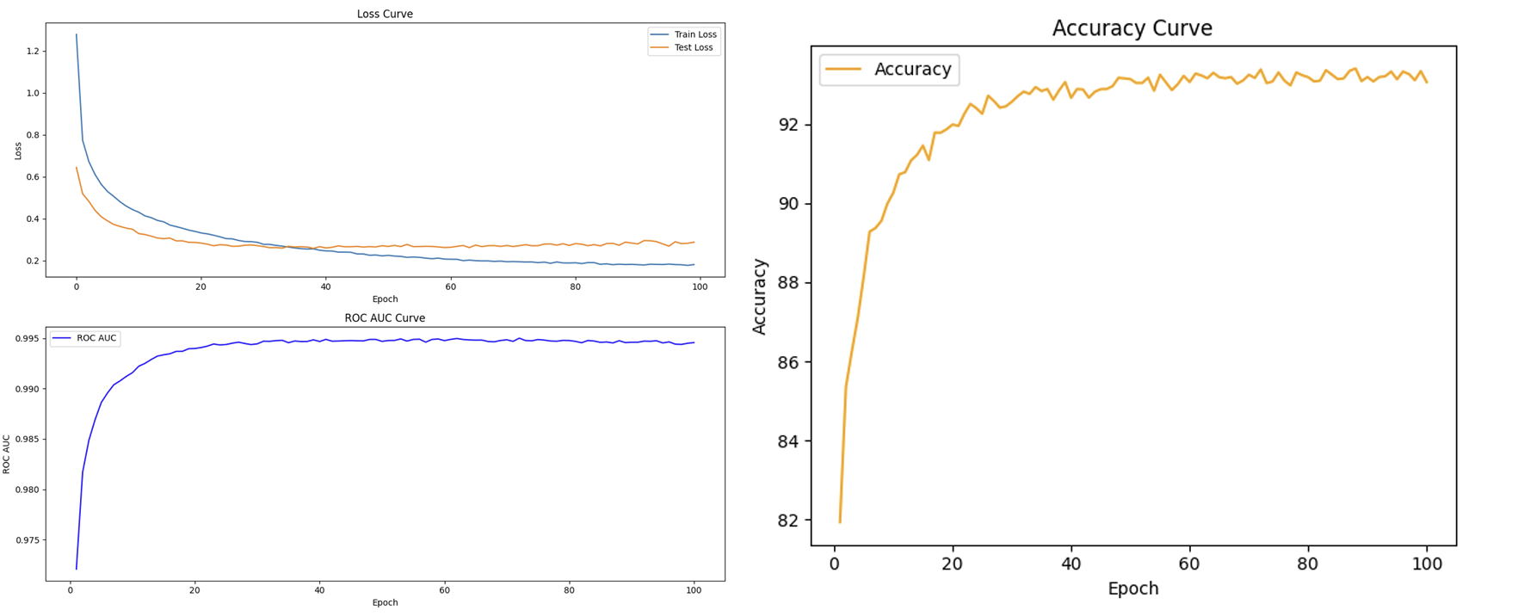
Adding a Dropout Layer

Slide 7
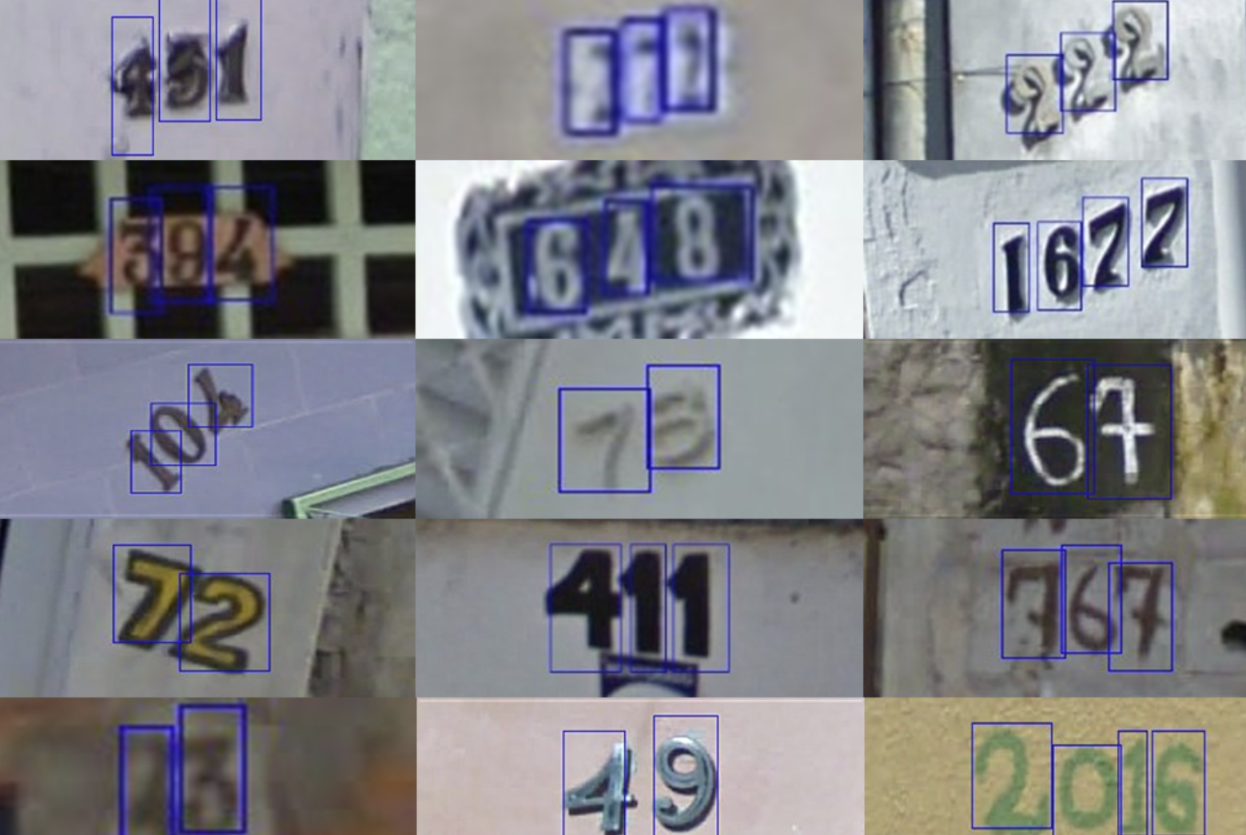
Rotate
BLUR

Slide 8
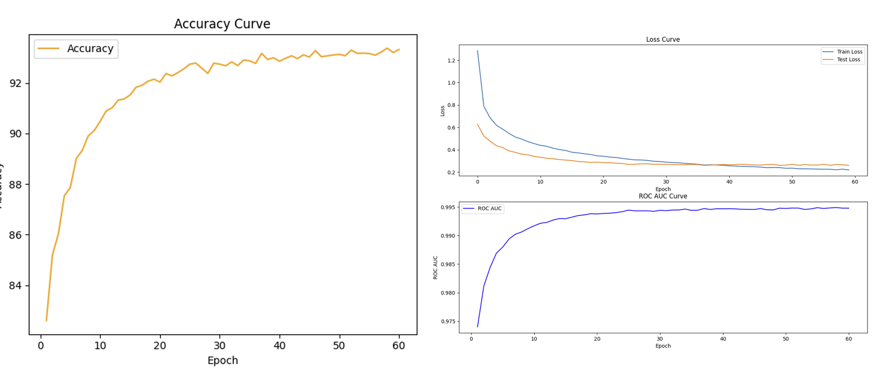

Slide 9
THANKS!

